Slide 1

MEDICAL STORE MANAGEMENT SYSTEM
Presented by:
Name: Damarasingu Gowtham bhaskar
Reg No: 22P31F0009
ADITYA COLLEGE OF ENGINEERING AND TECHNOLOGY
Internal Guide:
Ms.Mohammad.Gousia

Slide 2
INDEX
Abstract
Existing system
Disadvantages
Proposed system
Advantages
System architecture
Functional requirements
Non-functional requirements
Modules
Minimum software requirements
Minimum hardware requirements
UML Diagrams
Screenshots
Conclusion

Slide 3
ABSTRACT
The Medical store management system is designed to streamline operations and improve customer experience in the healthcare sector. The system includes key features such as inventory management, online ordering, payments and customer management.
The main aim of Medical store management system is to improve the efficiency of medical stores by providing real-time access to stock information, supporting transactions, and automating routine tasks. The system will focus on the overall healthcare service by ensuring the availability of medicines and providing a convenient platform for customers to access medical supplies.

Slide 4
EXISTING SYSTEM
The project includes only the branding and name of medicine and its difficult for uneducated and normal people to understand for what purpose the specific medicine is being used. Some of the current existing systems do not provide expiry dates.
Here are some common challenges and drawbacks associated with online medical store management system.

Slide 5
DISADVANTAGES
Limited accessibility, especially for individuals those who are not in remote areas.
Manual prescription handling can lead to errors in data entry, and record-keeping.
Managing inventory, leads to issues such as overstocking, stockouts, and expired medications.
Manual processes, including prescription verification, and customer service, can be time-consuming.
Limited information availability storing and retrieving patient information and prescription history.

Slide 6
PROPOSED SYSTEM
The project is being developed will contain the complete information about the medicine along with its expiry details. The user can also share the feedback by logging into our website.
Online medical stores offer various advantages of digital technology to streamline processes and enhance accessibility to healthcare products and services. Here are some key advantages of online medical store management system.

Slide 7
ADVANTAGES
Detailed information about medications including expiry date available on the platform
User privacy in online platforms provide a way for users to order sensitive medications without the need for face-to-face interactions
Users can browse and purchase medications and healthcare products from the comfort of their homes, 24/7.
Online medical stores eliminate the need for physical travel to saving time for users.
Online platforms often provide transparent pricing, allowing users to compare the costs of medications across different pharmacies.

Slide 8
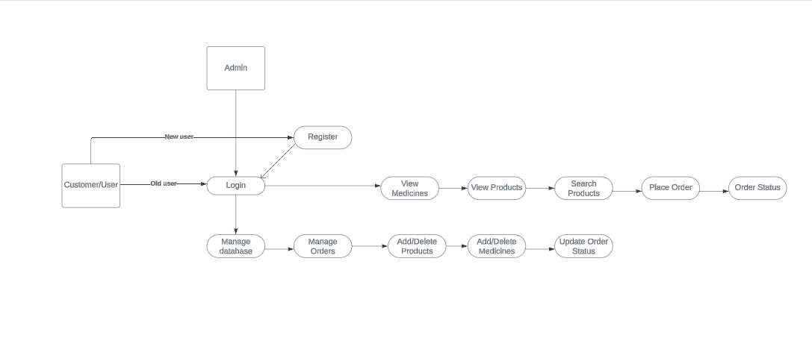
SYSTEM ARCHITECTURE

Slide 9
FUNCTIONAL REQUIREMENTS
The system should keep records of registration of customers.
The system should keep the records of medicines.
The system should keep the record of daily sell.
The system should keep the record of products.
The system should store the feedback given by the customer.
The system should keep details about the product it is delivered or not etc.

Slide 10
NON-FUNCTIONAL REQUIREMENTS
Only authorized employees of the firm can access the subsystem’s secured page.
Simple user interface has be created to make it easier to use.
The systems must always be accessible around the clock, every day of the week.
If a significant system fault occurs, it should be fixed within 1 to 2 working days to minimize disruption to business operations.

Slide 11
Modules
Inventory management: this module handles the availability of medicines and medical supplies, including stock and expiration dates.
Order management: allows users to place orders and get order status.
Customer management: manages customer profiles, including personal information, purchase history, preferences, and loyalty programs.
Security and access control: implements security measures to protect sensitive data.
User administration: allows administrators to manage user accounts, permissions, roles, and other administrative tasks related to system access and usage.

Slide 12
MINIMUM SOFTWARE REQUIREMENTS
Operating System : Windows 10
Technologies : Python 3.9
TOOLS : Visual studio

Slide 13
MINIMUM HARDWARE REQUIREMENTS
Processor : intel core i3
RAM : 4 GB
Hard Disk : 500 GB
Speed : 2.4 ghz

Slide 14
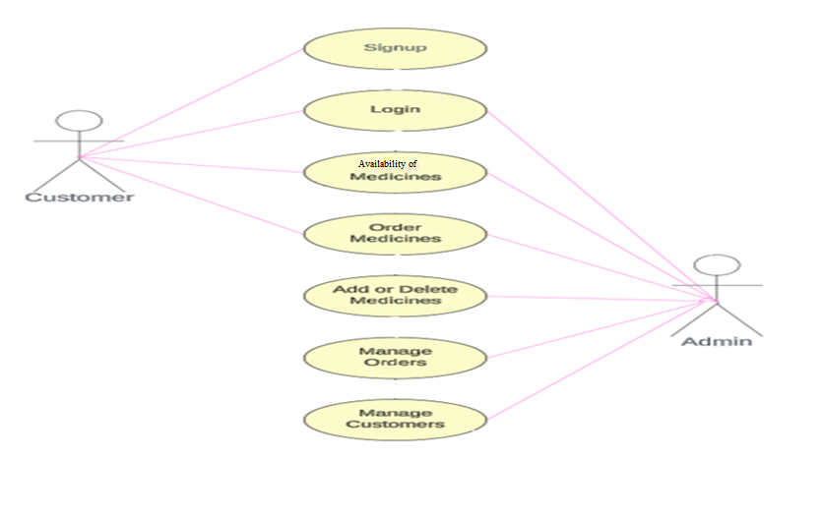
UML Diagrams
Fig: Use Case Diagram for system

Slide 15
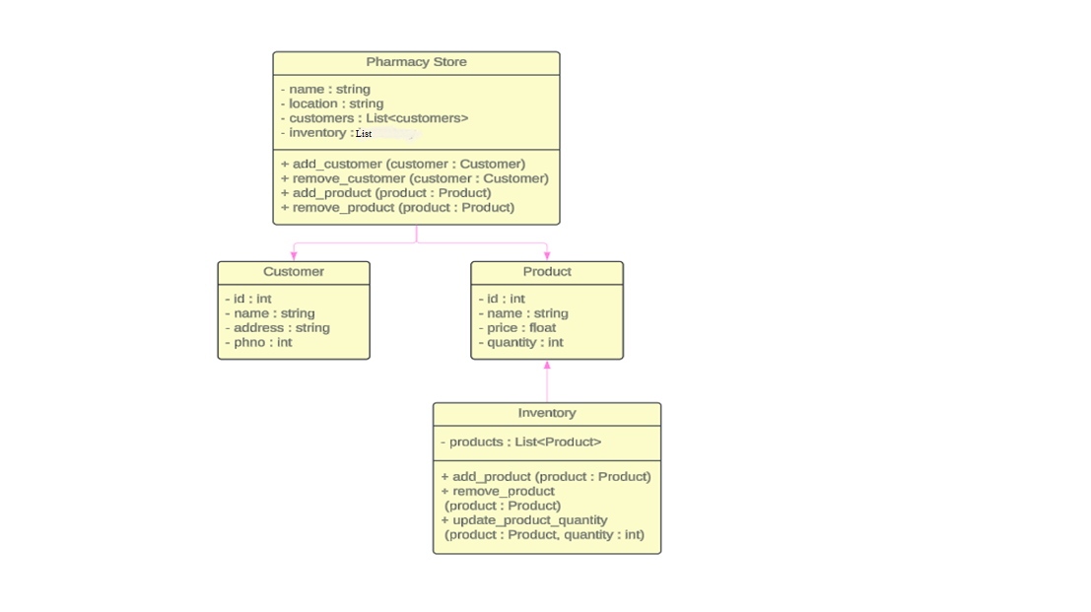
Fig: Class Diagram for system

Slide 16
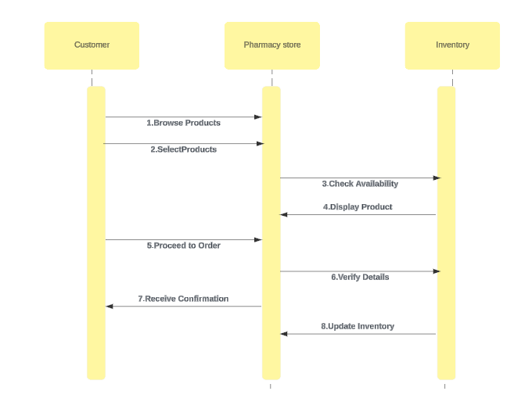
Fig: Sequence Diagram for system

Slide 17
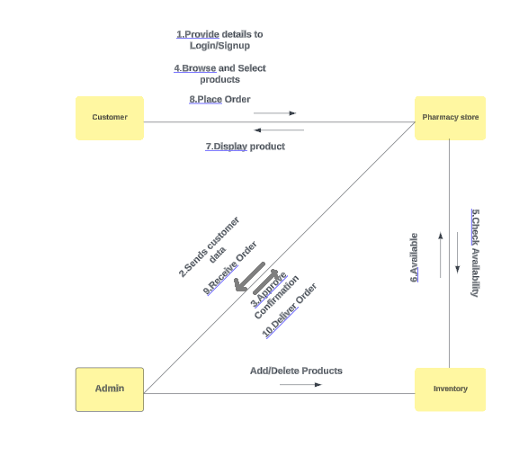
Fig: Collaboration Diagram for system

Slide 18
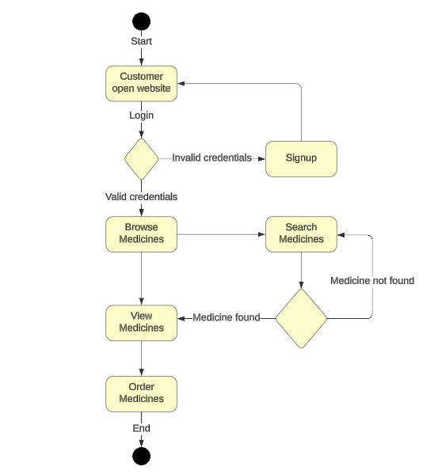
Fig: Activity Diagram for system

Slide 19
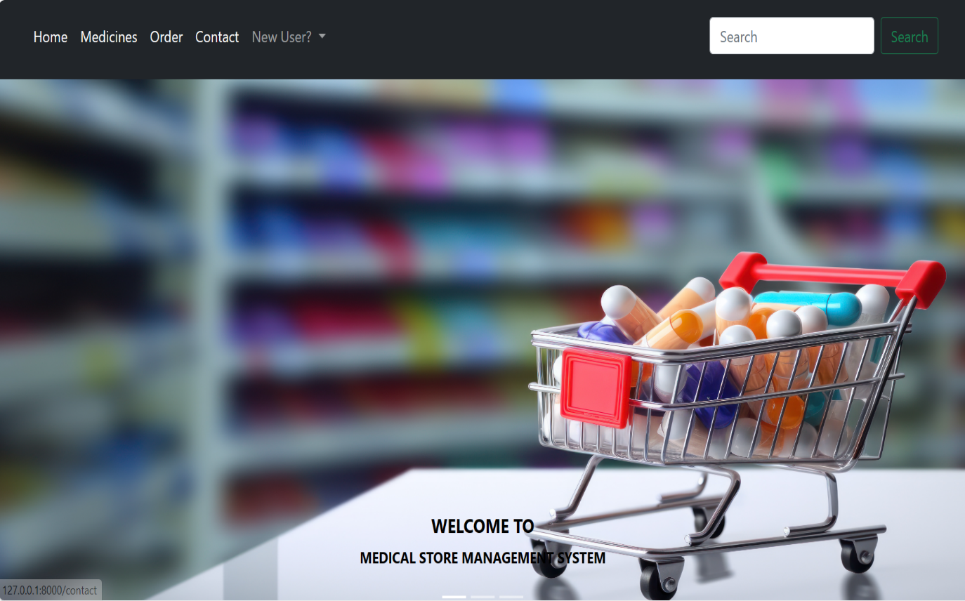
SCREENSHOTS
Description:- User interface of different categories Home page.

Slide 20
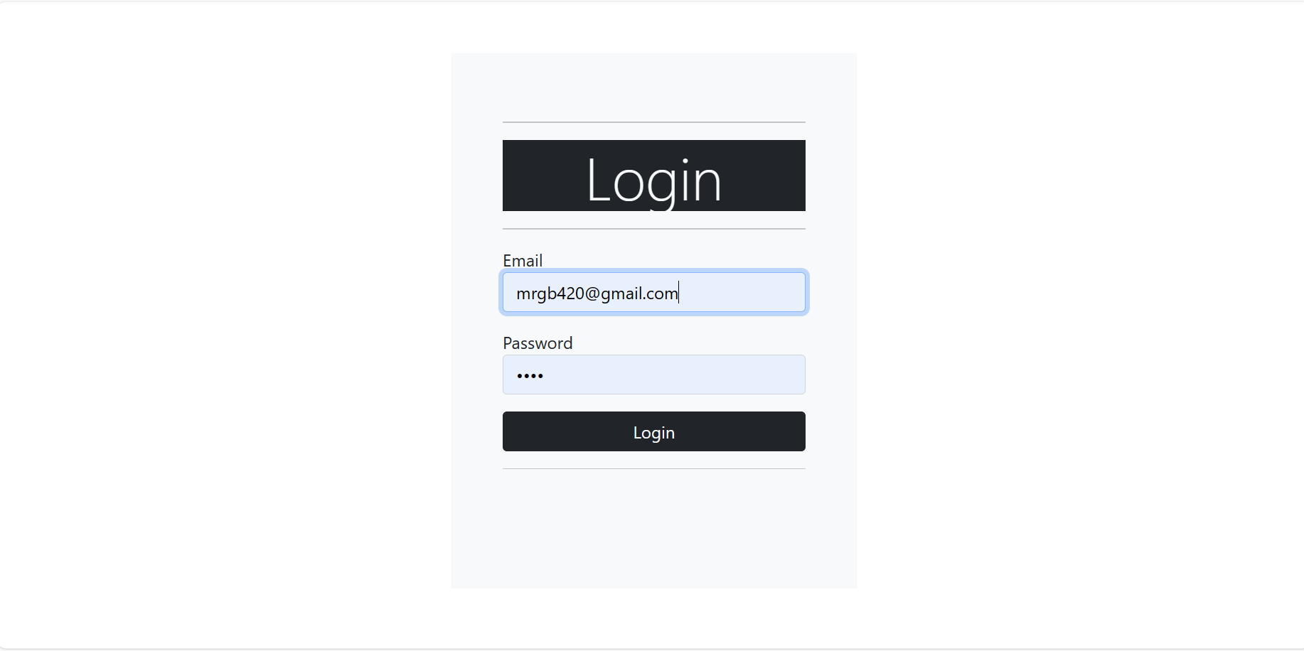
Description:- Existing user can directly login to account by giving login credentials and clicking on login button.

Slide 21
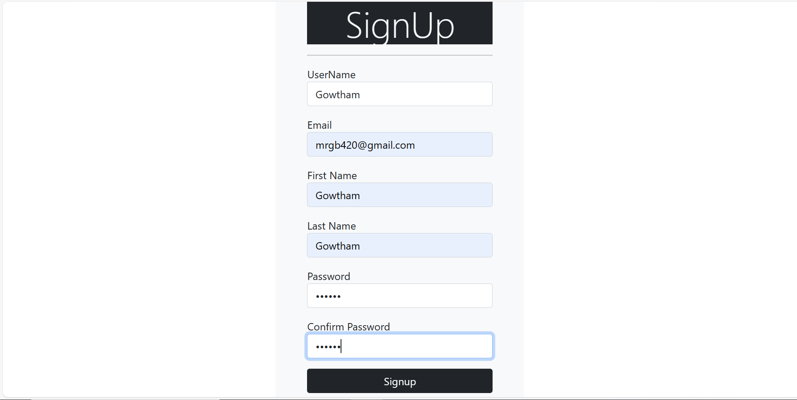
Description:- New user can signup to account by entering valid credentials and clicking on signup button.

Slide 22
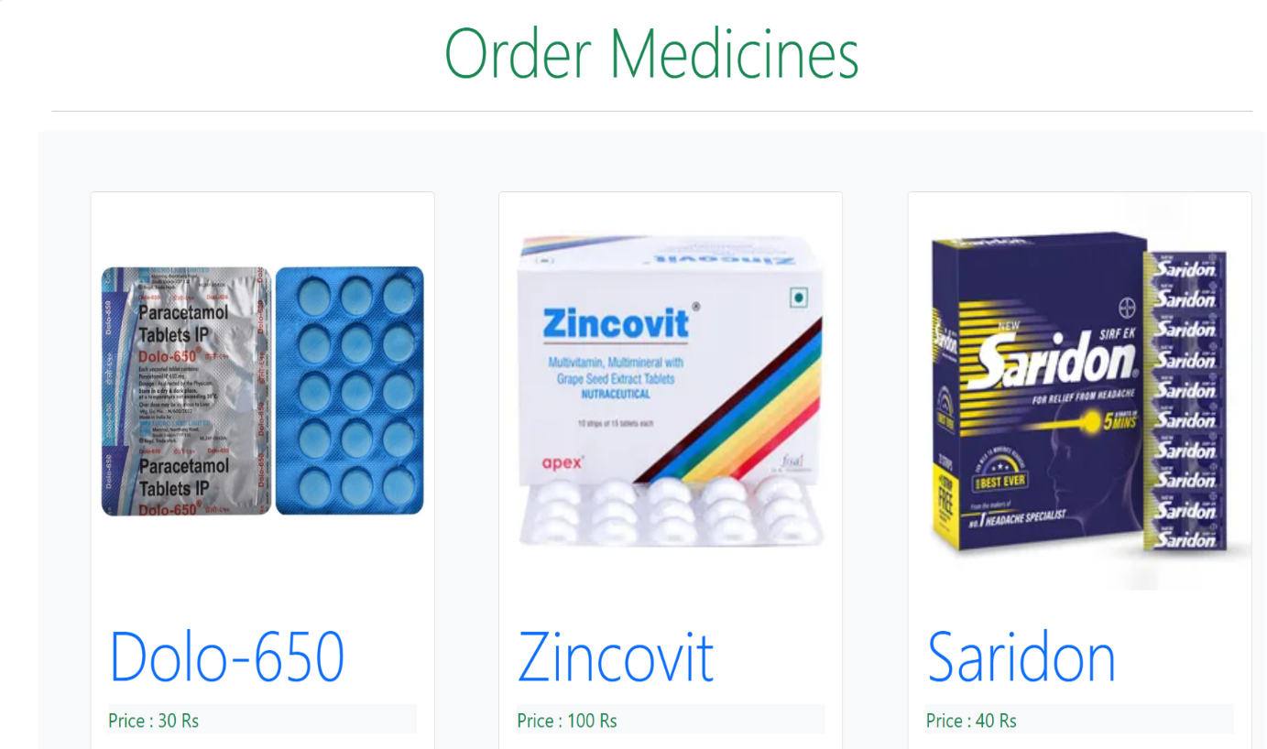
Description:- Displays all the Medicines available in our website.

Slide 23
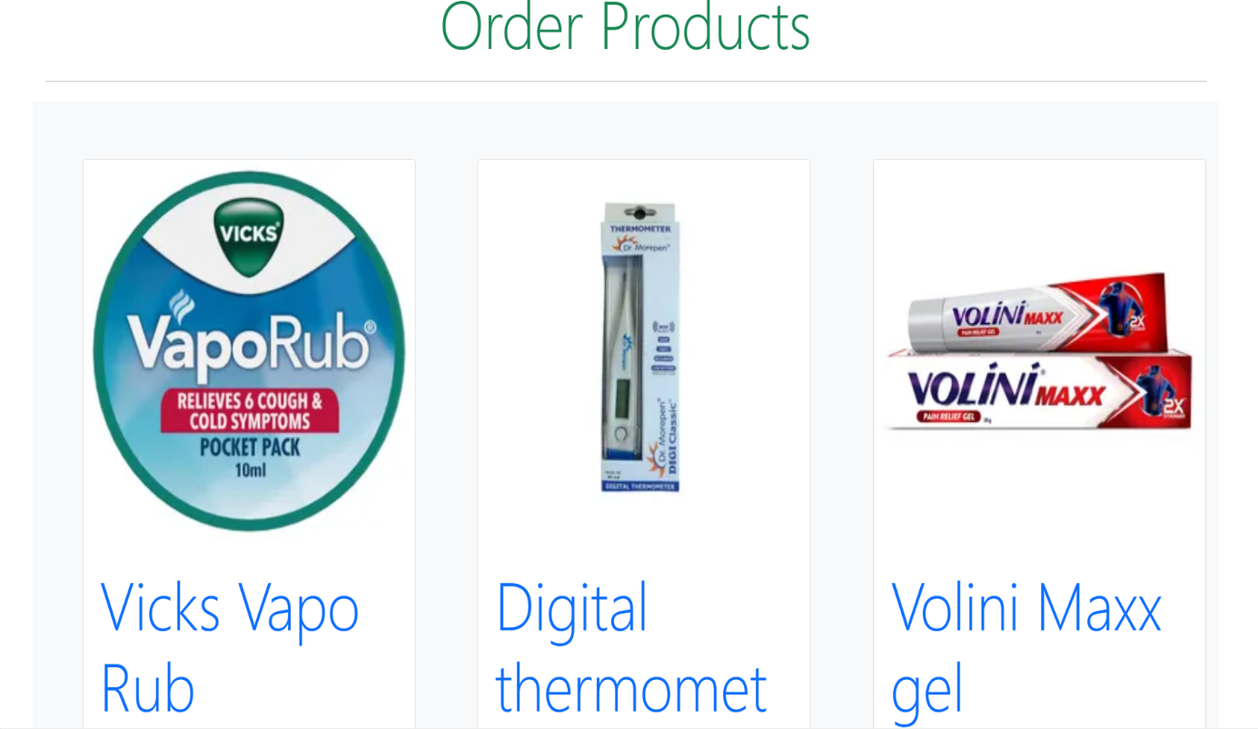
Description:- Displays all the Products that are available in our website.

Slide 24
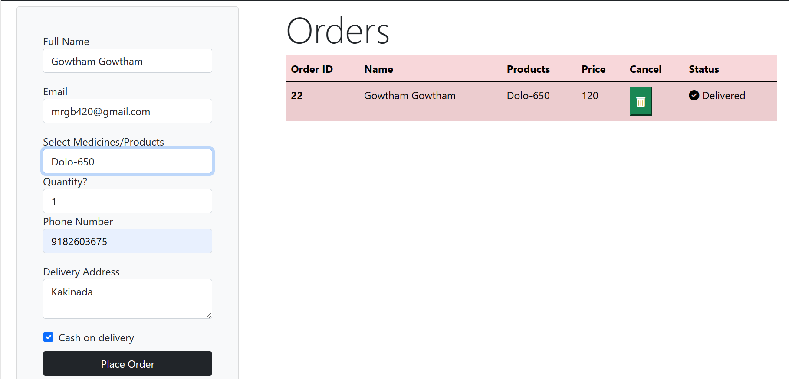
Description:- Contains details of every order of an user in our website.

Slide 25
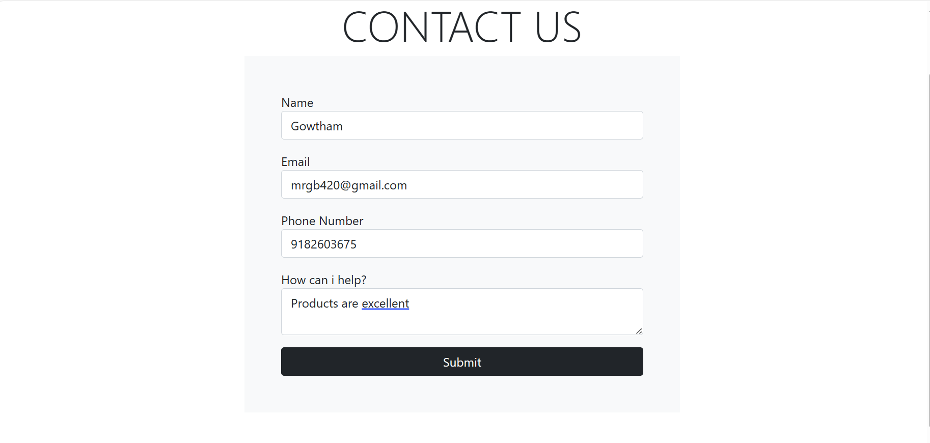
Description:- Helpful for user to provide the feedback about the website and orders.

Slide 26
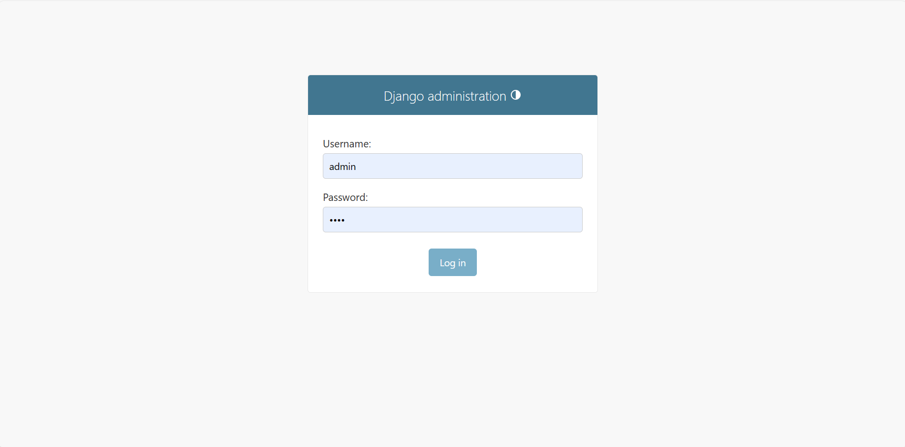
Description:- Administrator can login by Giving details and clicking on login button.

Slide 27
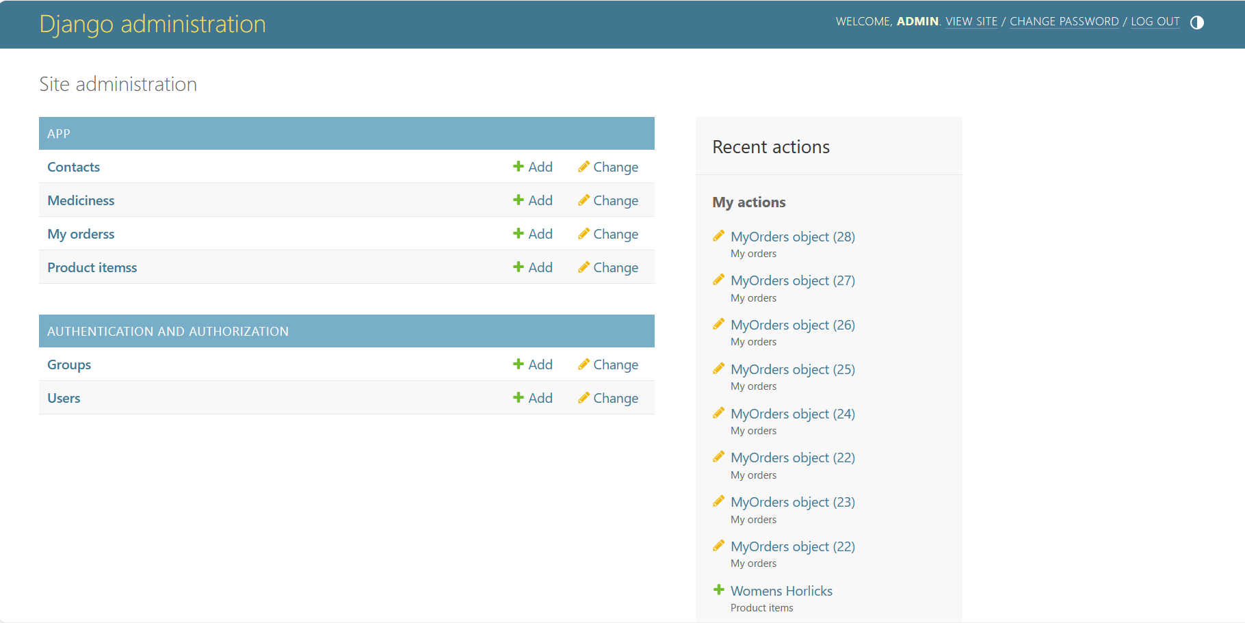
Description:- Contains details about the apps and authorizations.

Slide 28
CONCLUSION
In conclusion, the medical store management system has brought about significant changes in the way individual access and manage their healthcare needs. The convenience and accessibility offered by these platforms have proven to be valuable, especially in the context of modern, fast-paced lifestyles.

Slide 29
THANK YOU

Slide 30
ANY QUERIES

